Slide 1
Site Optimised Forecasts with XGBoost
Tennessee Leeuwenburg and MengMeng Han
Bureau of Meteorology
September 2023
Notes:
Accessibility information – delete after reading
We're all responsible for producing accessible documents. Use the accessibility checker to make sure your content is accessible to everyone.

Slide 2
Acknowledgments
MengMeng Han who is extending this work for more locations with more complex models (Multi Site Boost, aka MSB)
Brad Murphy who is contributing to the verification for MSB)
This system is still undergoing research and results have not been finalised or publishes, as such the final characteristics are very likely to change.
This information is provided to help inform the audience about what may be effective or how to approach research questions rather than to make exact claims about performance and accuracy.

Slide 3

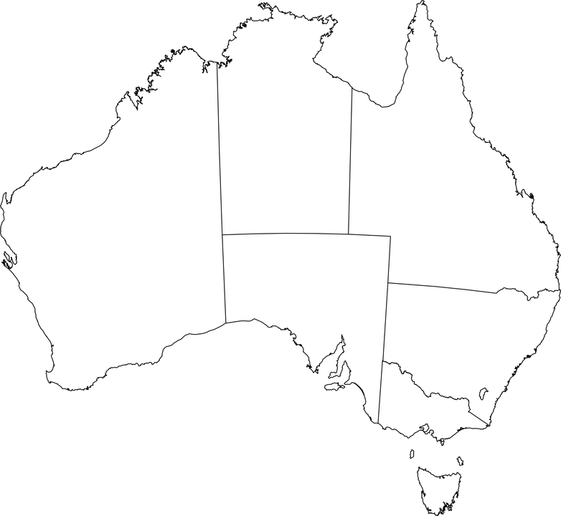
What is a Site Optimised Forecast
Image not to scale
An NWP model forecast is like a chessboard, which each square named a 'grid box'
If you live in the middle of a wide open plain, this may be a good representation
If you live sheltered by a cliff but near an ocean, that grid box may be a poor representation
Even a 'good' forecast value for your grid box may be a 'bad' forecast value to expect in your location
Even at the highest of resolutions (e.g. 300m) this problem still remains, if what you want is to know what's happening at a particular spot
E.g. conditions 50m out into the ocean just aren't the same as those 50m inland. Similar effects arise from mountains, lakes, streams and the built environment.
Site optimised forecasts attempt to correct (or 'localise') the gridded forecasts to exact spots.

Slide 4
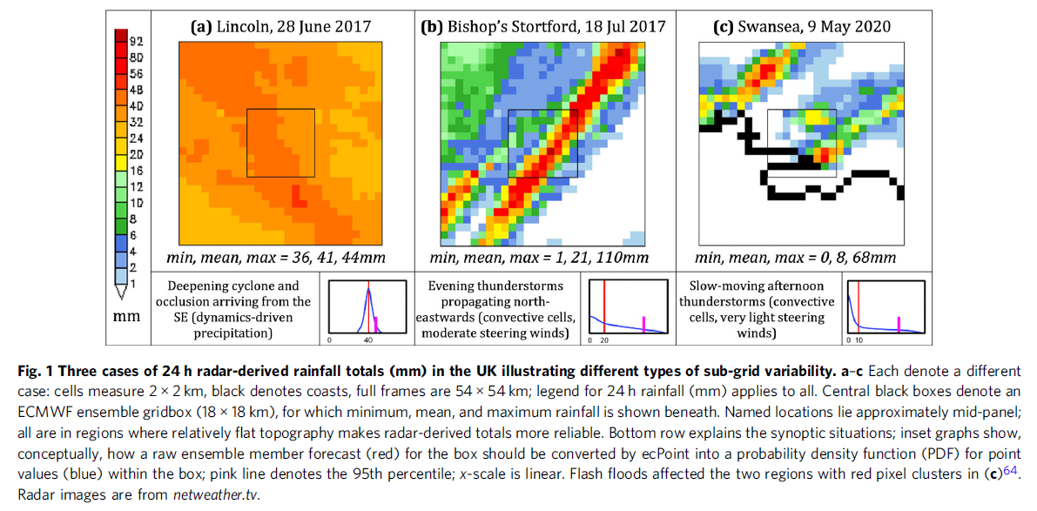
Background: Sub-grid-scale Variation
Hewson, Timothy David, and Fatima Maria Pillosu. "A low-cost post-processing technique improves weather forecasts around the world." Communications Earth & Environment 2.1 (2021): 132.
Notes:
Local variation within one numerical grid, and the need for site-specific bias-correction

Slide 5
What do people usually do about it?
Simple bias correction (i.e. add or subtract either a constant, or minimise a linear function) based on a single value
i.e. "22.4 Celsius" on the grid would always map to "20.8" at that location
See e.g. MOS, Gridded OCF and Site OCF
Sometimes, the gridded forecast value is replaced with the site optimised value due to expectations on how the gridded product will be later used
This works okay for some purposes, but there is further opportunity for forecast enhancement

Slide 6

Overview of SiteBoost
Incorporates a neighbourhood – the 3x3 set of grid boxes around a central location. Incorporating this information is essential.
Incorporates multiple variables – in particular the wind direction significantly informs the temperature
Incorporates the hour of the day to allow the model to account for how time-of-day might affect things, such as predictable morning and evening coastal cycles
Utilises a gradient boosting decision tree for the model
Corrects a single time-step from the model
A series of model time steps can be corrected to produce the full correct forecast for a location

Slide 7




Scope of Work
New Data
Historical Data
Forecast
Temperature
Temperature
ML Model
NWP Forecast
Wind
Dew Point
Dew Point
Site-specific Observation
'Better' Forecast
NWP Forecast
Notes:
Scope of work: train ML model with historical fcst and obs data, so that a better forecast can be made when new fcst data becomes available

Slide 8
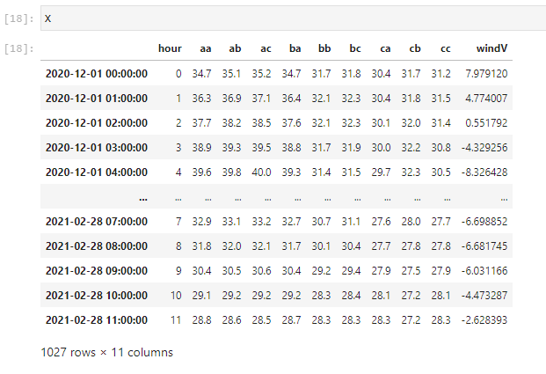

Slide 9
Preliminary Results (Single Site Boost)
Source | Statistic | Value | Degree of Improvement
Best gridded | Mean absolute error (when temp > 30) | 0.564 | -
XGB4 Model | Mean absolute error (when temp > 30) | 0.436 | 0.128
Expert manual | Mean absolute error (when temp > 30) | 0.383 | 0.053
Daily min and max are better captured
Extreme events are handled reasonably well
Important to remember this system is providing the gridded correction, not the model prediction

Slide 10
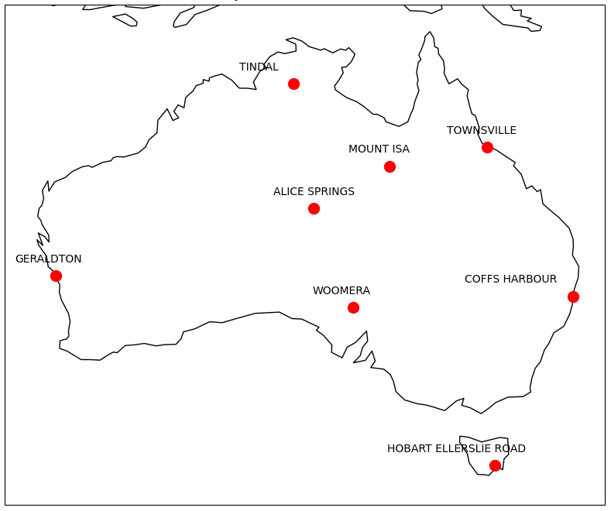
Overall Metrics (Multi Site Boost)
RMSE Hourly, TMP (DEW)
RMSE Daily Max TMP (DEW)
-8.9%
(10.9%)
46.1%
(21.8%)
40.2%
(25.1%)
100.3%
(68.9%)
8.6%
(35.4%)
-40.8%
(8.1%)
23.1%
(103.6%)
33.2%
(81.5%)
-7.6%
(243.2%)
41.2%
(131.1%)
15.6%
(28.5%)
63.9%
(-8.1%)
10.9%
(22.8%)
8.5%
(11.1%)
19.8%
(18.0%)
36.5%
(4.4%)
Average gain of a metric compared with IMPROVER across all lead days, positive means better
Notes:
Average gain of each metric over all lead days, all sites

Slide 11
Next Steps
Our focus:
  Get more data, perform rigorous evaluation, and publish
  Data assimilation to provide realtime updates
Opportunities for further research
  Explore whether the model can work at unseen locations
  Explore the use of more input variables
  Incorporate more information on seasonality
  Incorporate information from multiple sites at once
The NOAA ISD database provides an open data repository which can support this work in an academic context
Multiple sources of gridded model data are available for research groups to utilise

Slide 12
Thank you
Tennessee Leeuwenburg and MengMeng Han
Tennessee.Leeuwenburg@bom.gov.au
Mengmeng.Han@bom.gov.au=

