Slide 1
Genomics observations to constrain oceanic BGC/ecosystem models
Levente Bodrossy, Claire Davies, Jason Everett, Beth Fulton, Trevor Hutton, Jodie van de Kamp, Anthony Richardson, Tyler Rohr, Amaranta Focardi, Michaela Larsson, Eric Raes, Ian Paulsen, Martina Doblin, Martin Ostrowski

Slide 2

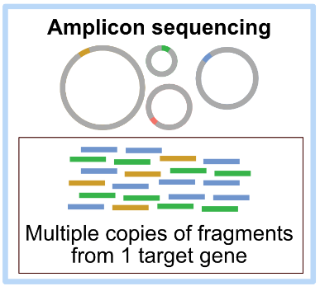
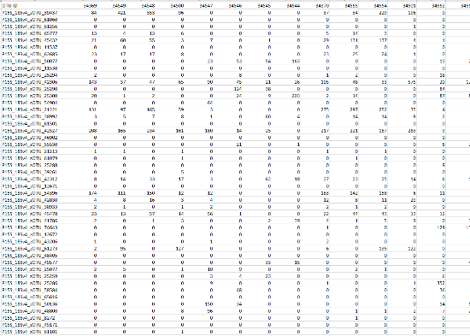



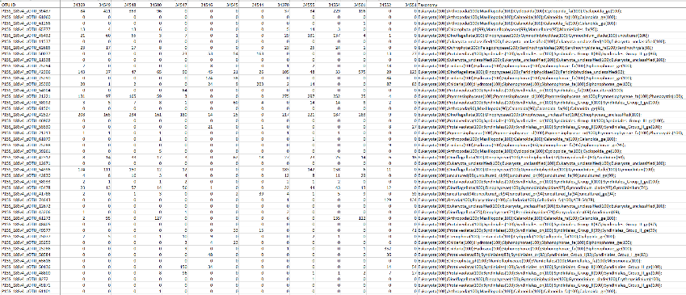
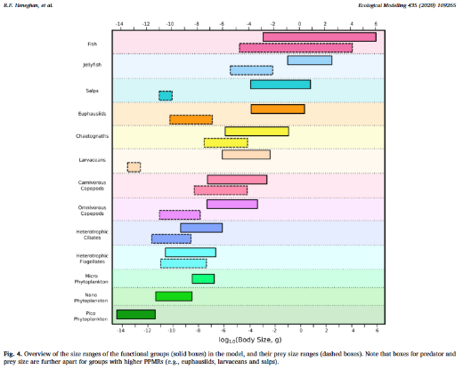
Genomics/eDNA observations of the pelagic ecosystem
OTU abundance table
Binning OTUs
... e.g. into functional groups
Adding taxonomy

Slide 3
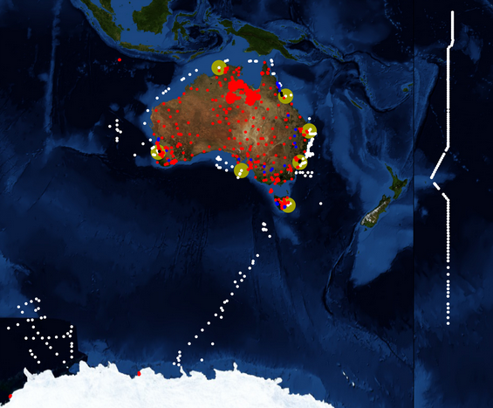


We have a lot of data!
~4000 pelagic samples from Australian marine waters and the Southern Ocean, spanning
latitudes from 0 - 62 °S
depths from surface to ~6,000m
... more in progress
... even more to come

Slide 4
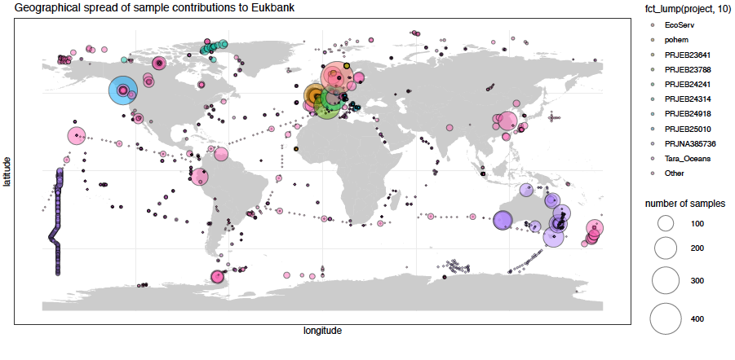
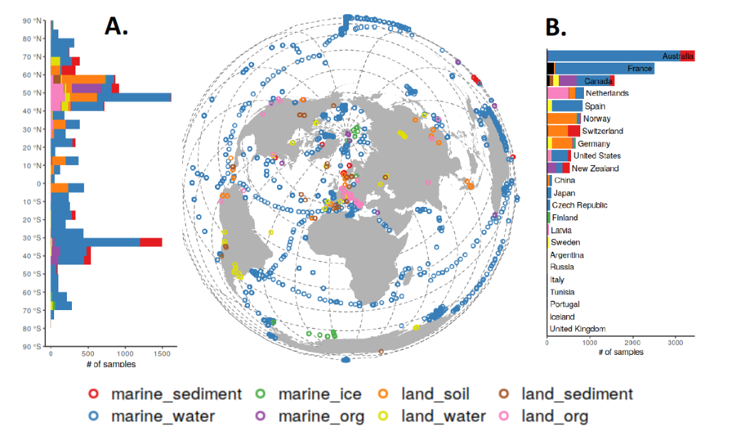
Global ‘EukBank’ dataset ~8000 marine samples

Slide 5
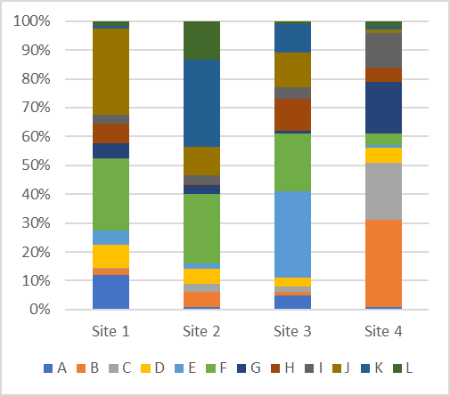
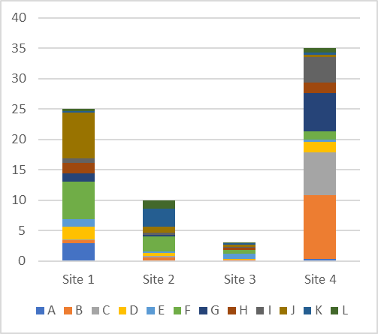
Compositional vs. quantitative observations

Slide 6
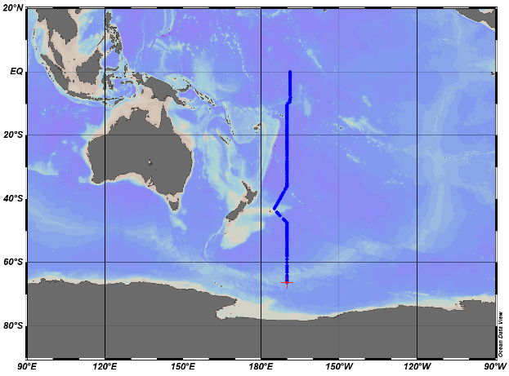
Options for quantification
P15S GO-SHIP voyage
May-June 2016
... after practical considerations
... within the Australian Microbiome
Microscopy counts (phytoplankton, copepods) (NRSs)
Flow cytometry counts (bacteria, pico- and nanophytoplankton) (NRSs, P15 GO-SHIP line)
18S qPCR (~total eukaryote biomass) (need access to genomic sample)
eDNA concentration (~total biomass) (need access to genomic sample)
2016 P15S GO-SHIP line first to demonstrate qPCR; easy to interpret and sanity check against expected broad trends
NRSs next; confirm/calibrate quantification using all 3 quantitative datastreams

Slide 7
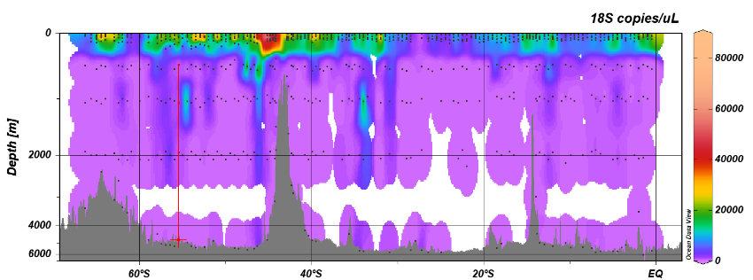
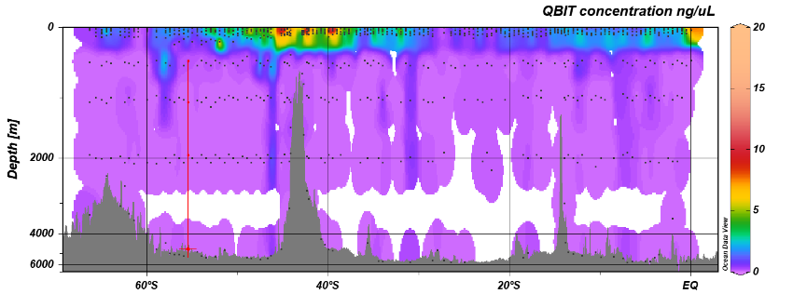
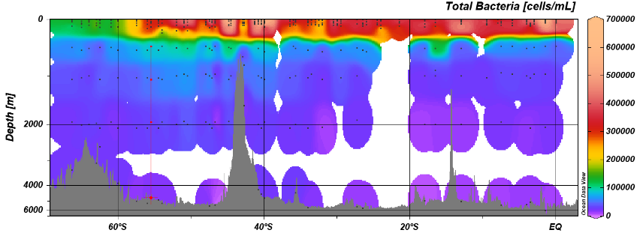
Datasets FOR quantification, 2016 P15S GO-SHIP line
Variability
18S qPCR (copies/uL)
100x
16x
100x
eDNA (ng/uL)
100x
21x
50x
Bacterial flow cytometry (cells/mL)
3x
8x
4x

Slide 8
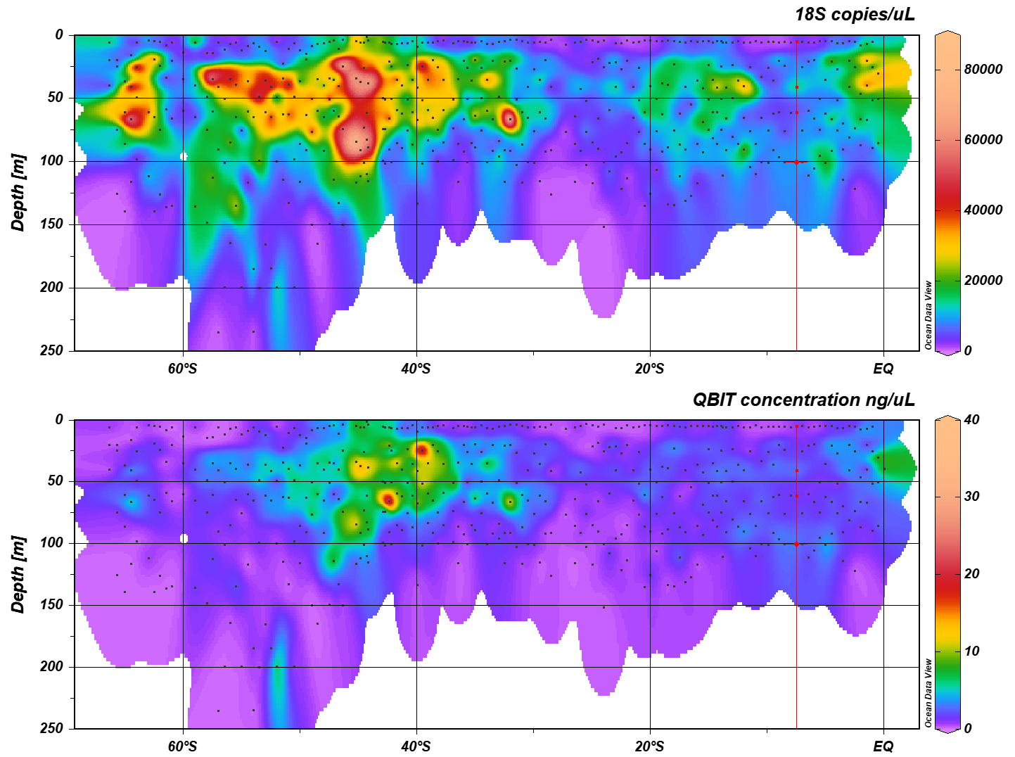
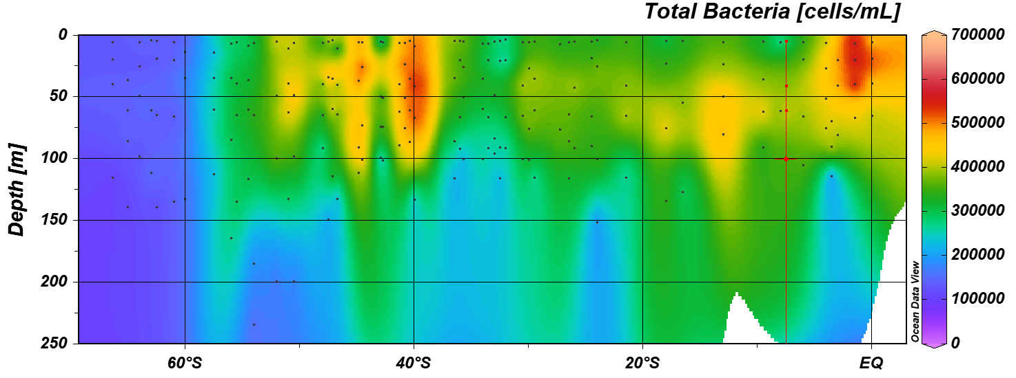
Full depth Epipelagic zone
18S qPCR (copies/uL)
18S qPCR (copies/uL)
eDNA (ng/uL)
eDNA (ng/uL)
Bacterial flow cytometry (cells/mL)
Bacterial flow cytometry (cells/mL)

Slide 9
Quantifying compositional data
Compositional data
Dataset for quantification
Quantitative data

Slide 10
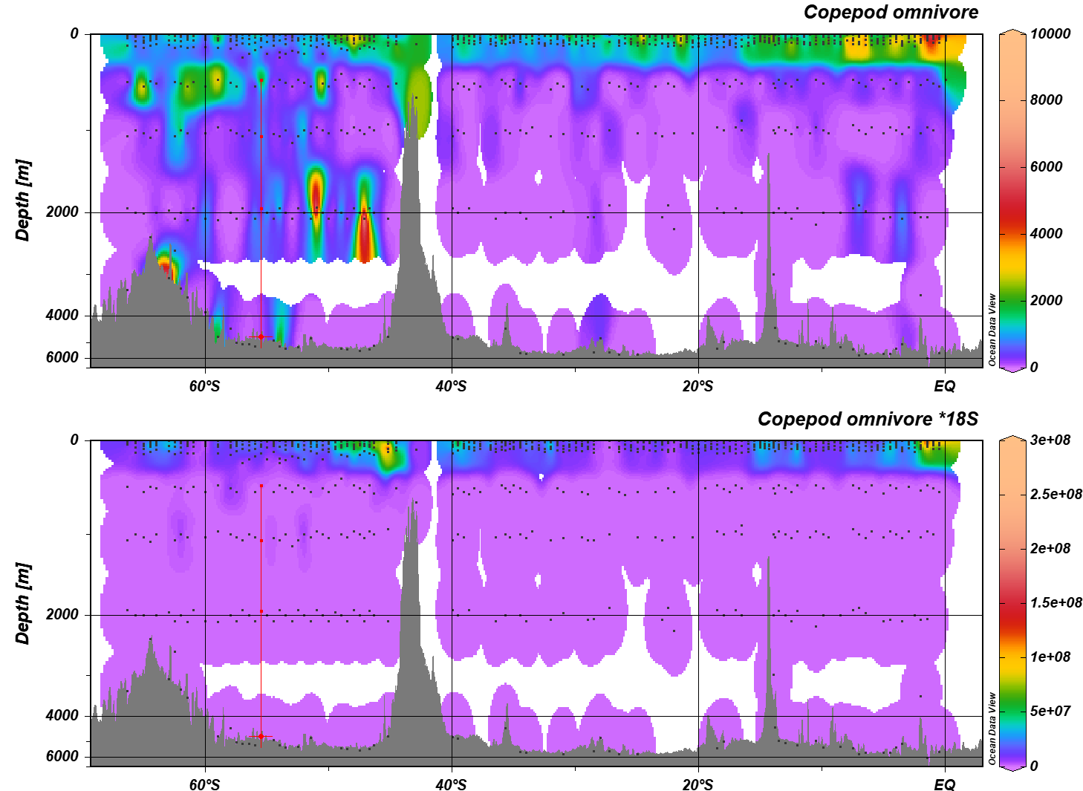
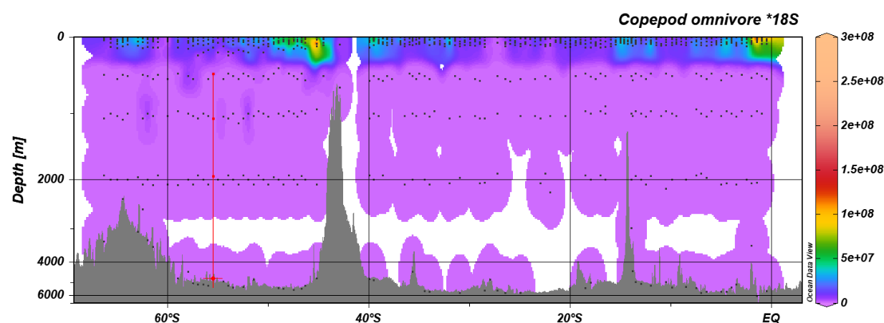
Quantifying compositional data
Compositional data
Dataset for quantification
Quantitative data

Slide 11
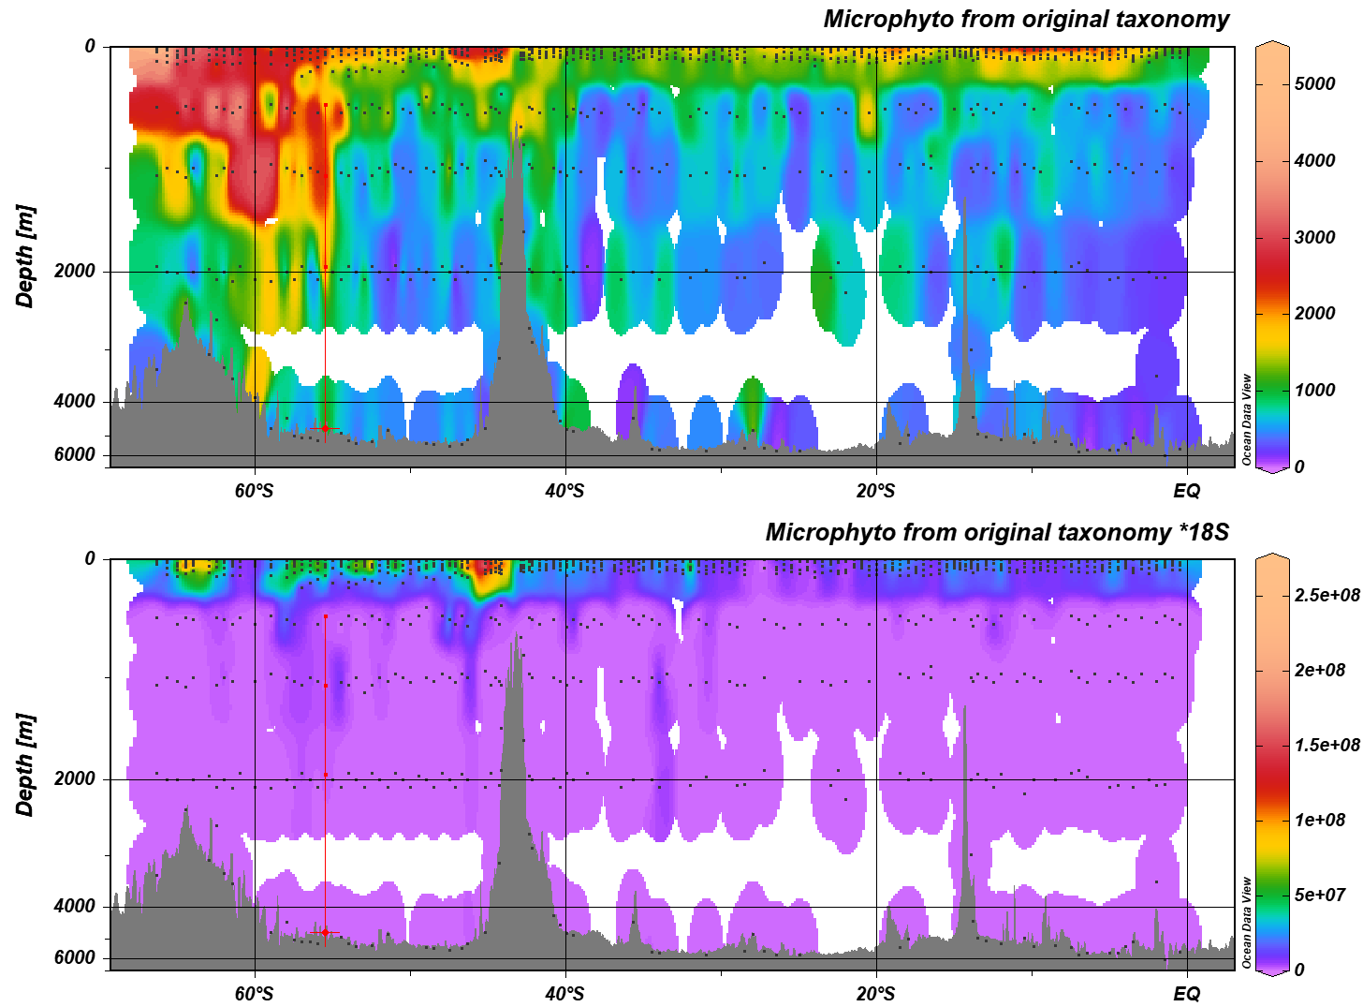
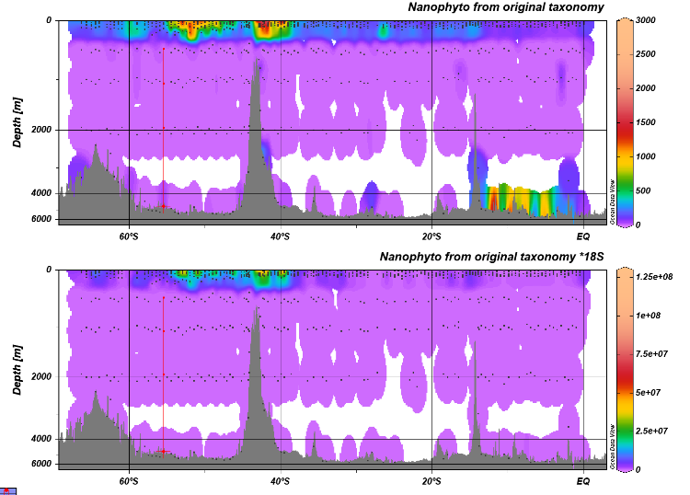
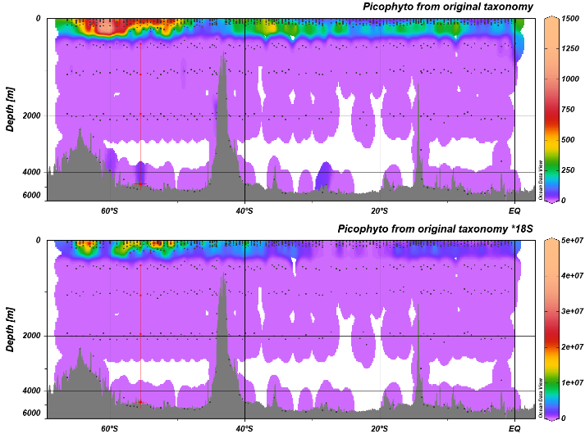
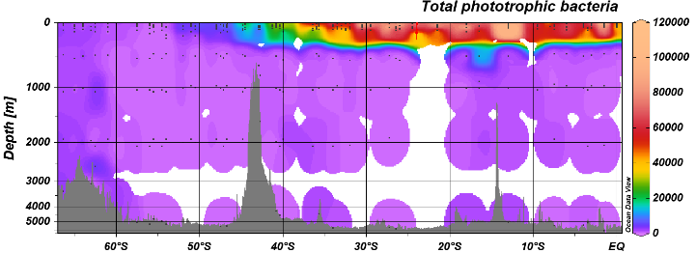
Phytoplankton, full depth
Micro phytoplankton Nano phytoplankton Pico phytoplankton
Compositional
Quantitative
Cyanobacteria

Slide 12
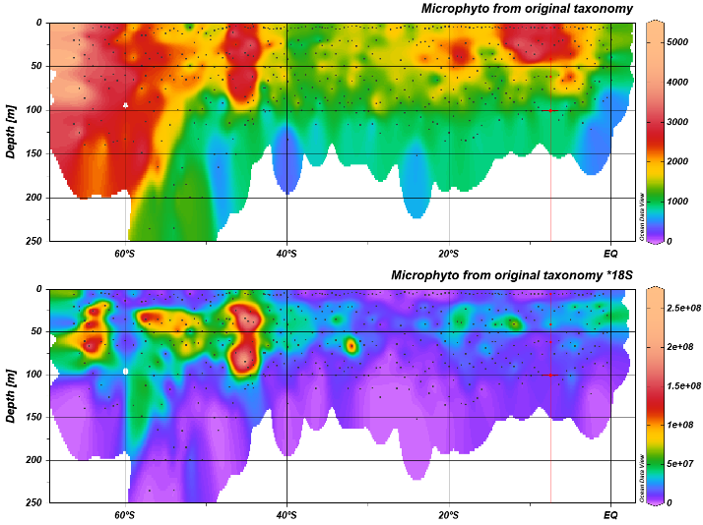
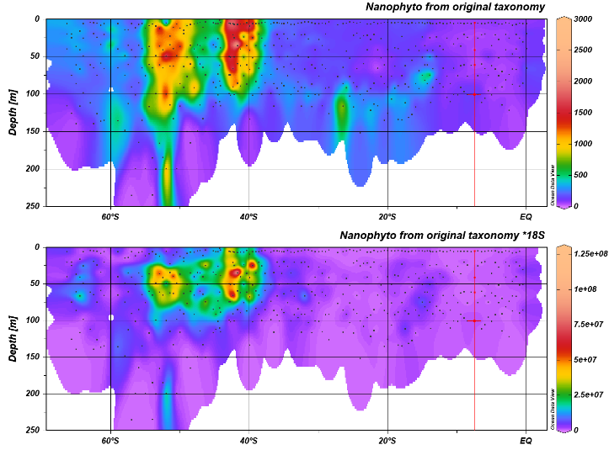
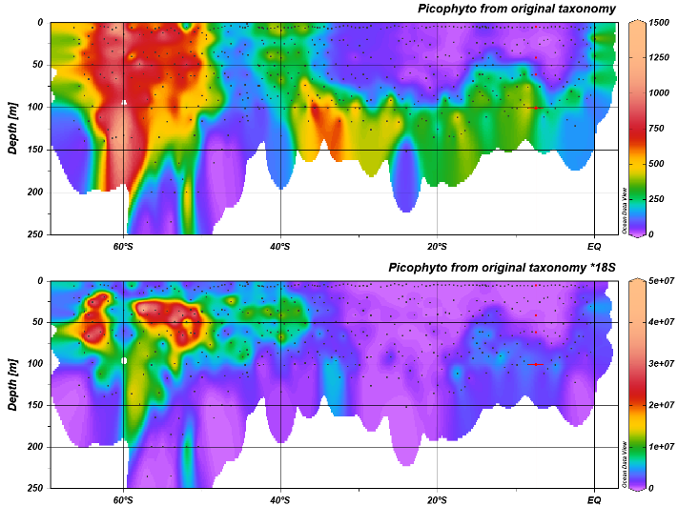
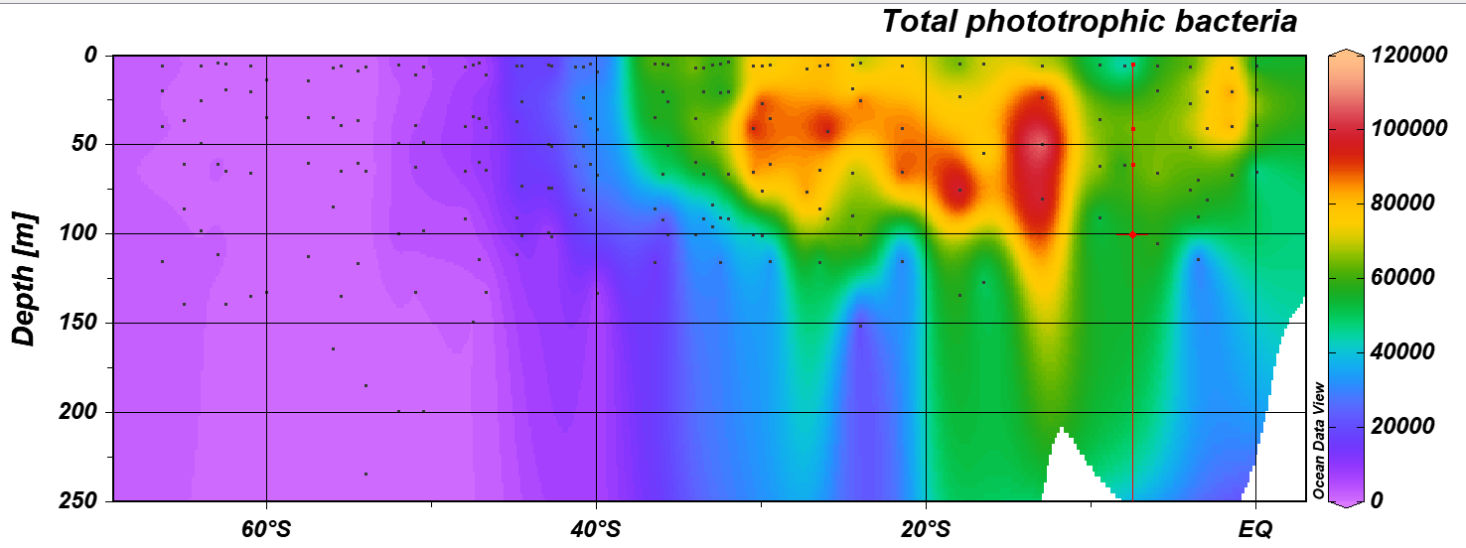
Phytoplankton, epipelagic zone
Micro phytoplankton Nano phytoplankton Pico phytoplankton
Compositional
Quantitative
Cyanobacteria

Slide 13
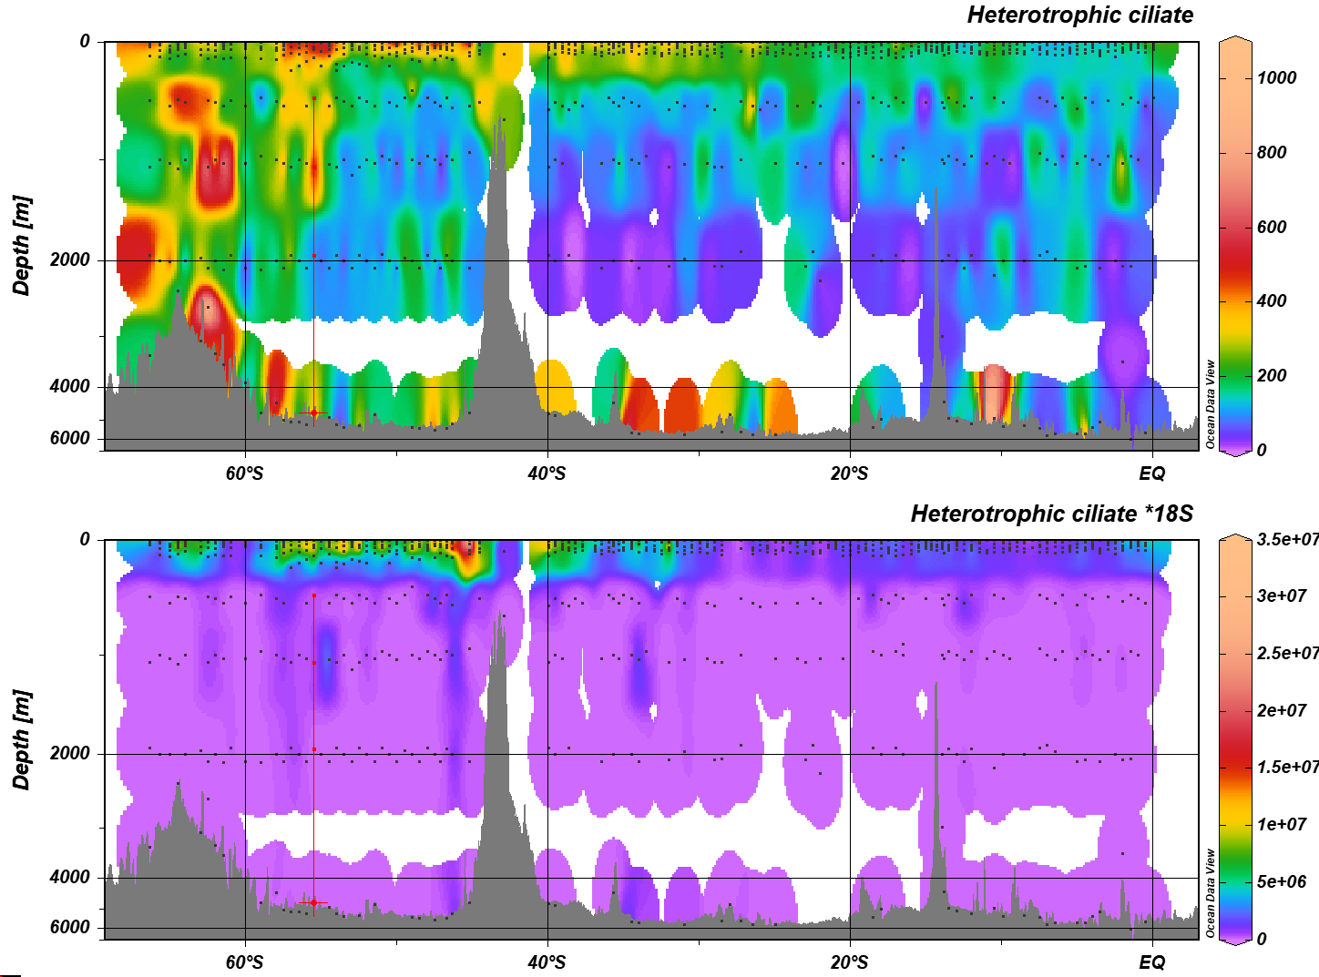
Ciliates and copepods – full depth
Heterotrophic cilates Omnivorous copepods
Compositional
Quantitative

Slide 14
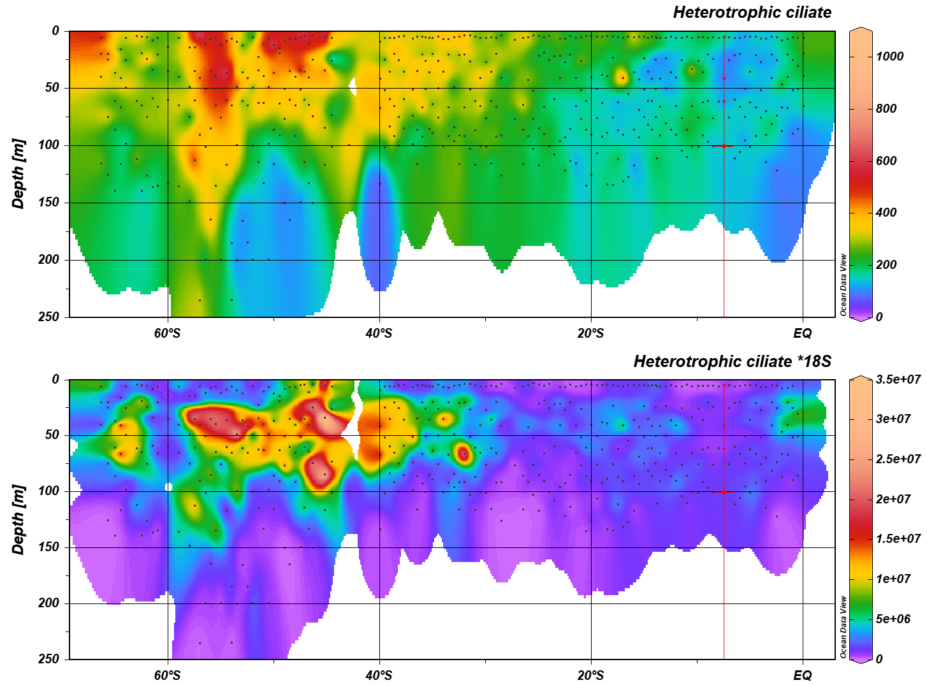
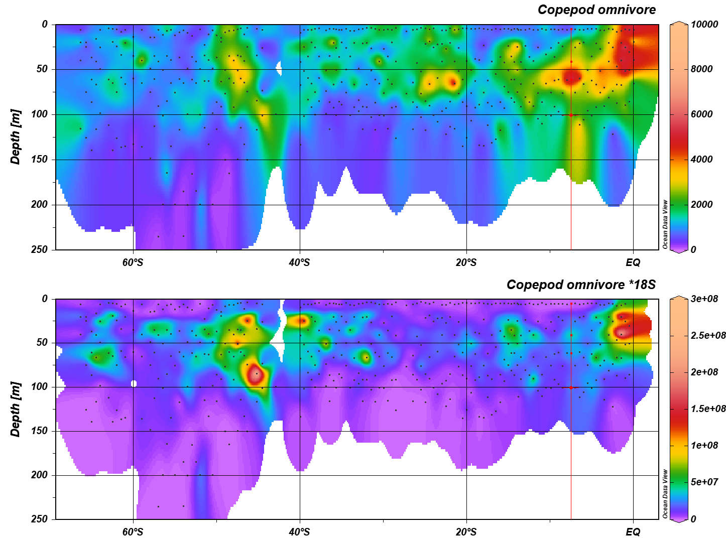
Ciliates and copepods – epipelagic zone
Heterotrophic cilates Omnivorous copepods
Compositional
Quantitative

Slide 15
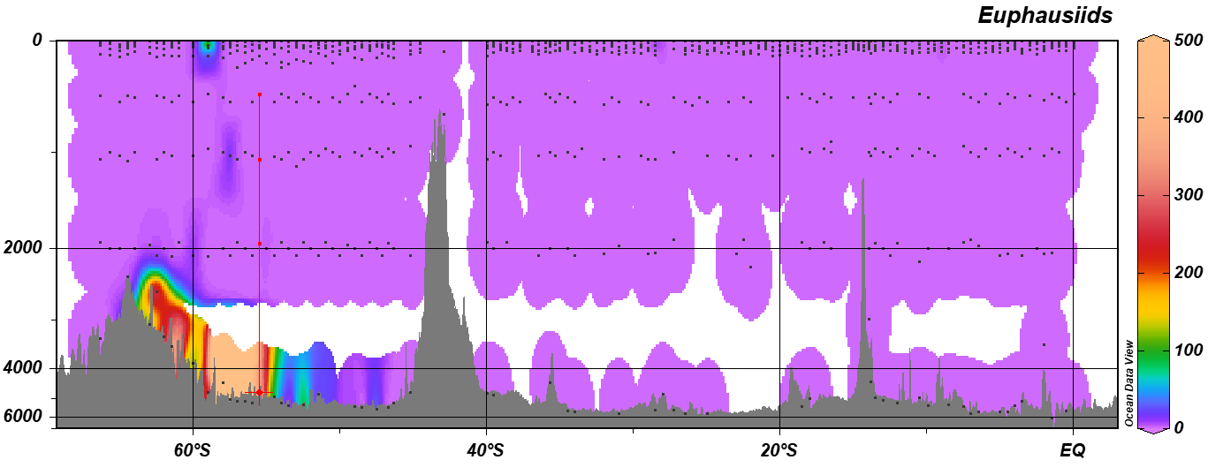
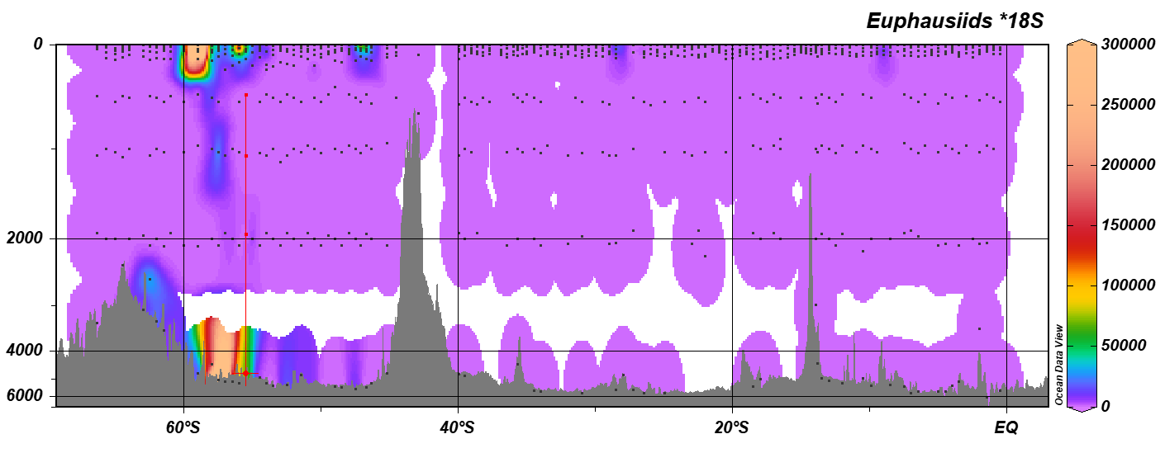
Krill
Compositional
Quantitative

Slide 16
Summary
18S qPCR delivers data for quantification of compositional genomics observations
First sanity check passed
Next:
  Work on NRS data; confirm/calibrate quantifications
  Feed into ecosystem models
  Develop and apply qPCR on bacterial 16S and archaeal 16S

Slide 17
Thank you
Modelling
Claire Davies
Jason Everett
Beth Fulton
Trevor Hutton
Anthony Richardson
Tyler Rohr
Genomics work
Jodie van de Kamp
Eric Raes
Swan Li San Saw
Andrew Bissett
Flow cytometry
Amaranta Focardi
Michaela Larsson
Eric Raes
Ian Paulsen
Martina Doblin
Martin Ostrowski

Slide 18
Phytoplankton species X
M_{T} Total biomass (ug/L)
D
V_{T} Total biovolume (uL/L)
V
N_{T} Abundance (cells/L)
Flow cytometry
Genome
size
[eDNA] eDNA amount (ng/L)
Qubit DNA assay
18S copy
number
18S 18S copy number (copies/L)
qPCR assay
CLP 16S Chloroplast 16S copy number (copies/L)
CLP/cell
CLP 16S copy number

Slide 19
Biomass trends
Bacterial flow cyto
  Epi vs bathypelagic: ~8x
  Range: 3x (epipelagic) 4x (bathypelagic)
18S qPCR
  Epi vs bathypelagic: ~16x
  Range: 100x (epipelagic) 100x (bathypelagic)
[eDNA]
  Epi vs bathypelagic: ~21x
  Range: 100x (epipelagic) 50x (bathypelagic)
above 250m | Total Bacteria (cells/mL) | Total Eukaryotes (events/mL) | 18S copies/uL | QBIT concentration ng/uL
Max | 6.83E+05 | 5.40E+03 | 8.84E+04 | 3.74E+01
90th Perc | 5.32E+05 | 2.72E+03 | 3.47E+04 | 6.36E+00
Average | 3.31E+05 | 1.47E+03 | 1.36E+04 | 2.44E+00
10th Perc | 1.37E+05 | 4.30E+02 | 3.12E+02 | 6.88E-02
Min | 3.50E+03 | 7.00E+01 | 2.42E-01 | 1.73E-04
below 350m | Total Bacteria (cells/mL) | Total Eukaryotes (events/mL) | 18S copies/uL | QBIT concentration ng/uL
Max | 1.27E+05 | 5.17E+03 | 2.49E+04 | 2.70E+00
90th Perc | 6.94E+04 | 1.13E+03 | 1.67E+03 | 2.26E-01
Average | 4.00E+04 | 6.06E+02 | 8.40E+02 | 1.16E-01
10th Perc | 1.34E+04 | 1.30E+02 | 1.28E+01 | 8.90E-03
Min | 1.50E+03 | 0.00E+00 | 4.23E-02 | 2.30E-05
Change (times more in epipelagic zone) | Total Bacteria (cells/mL) | Total Eukaryotes (events/mL) | 18S copies/uL | QBIT concentration ng/uL
Max | 5.4 | 1.0 | 3.6 | 13.9
90th Perc | 7.7 | 2.4 | 20.8 | 28.1
Average | 8.3 | 2.4 | 16.2 | 21.1
10th Perc | 10.2 | 3.3 | 24.3 | 7.7
Min | 2.3 | #DIV/0! | 5.7 | 7.5

Slide 20
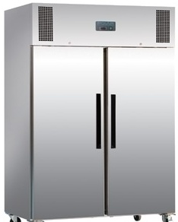
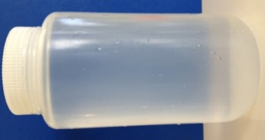

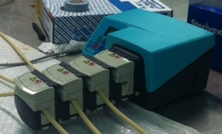

Samples – Example: Australian contributions to EukBank
2L* seawater
Sterivex filter
-80 °C
Multihead peristaltic pump
DNA extraction
500-3000 ng DNA

Slide 21
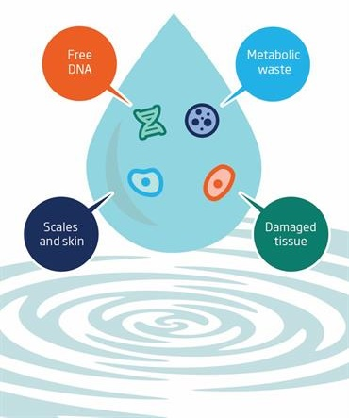
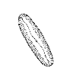
Sources of eDNA in water
Whole organisms
Microbiota
?? (half life; filter size)
Could be any prey – random outliers?
Macrobiota

